Slide 1
Caravan of Hope
An action of solidarity in response to the 2001 earthquakes in El Salvador

Slide 2
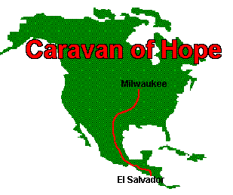
The Idea
Pastor Walter Baires was serving as a mission pastor from El Salvador at Ascension ELCA in Milwaukee. He was moved to action and suggested the Greater Milwaukee Synod sponsor a relief effort and drive supplies to El Salvador. Leaders from St. John’s in Brookfield led the efforts…

Slide 3
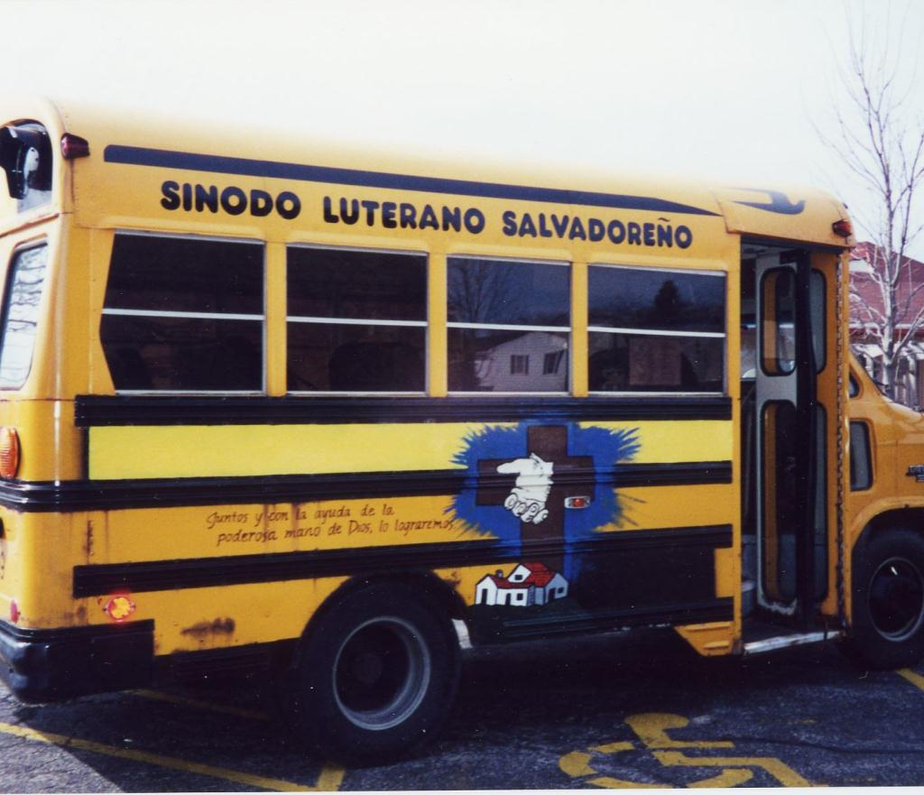
We bought a bus…
…and purchased a used school bus. Zeman Tool of Waukesha, WI allowed St. John’s to park the bus inside so it could be painted.

Slide 4
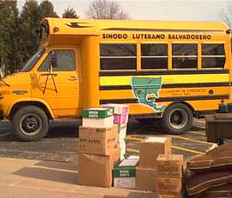
Packing
Volunteers painted the route on one side of the bus and the Luther Seal on the front. The bus was packed it with a collection of tools, tarps, mattresses, sewing machines, clothing and shoes…all of which were donated by churches from around the synod.

Slide 5
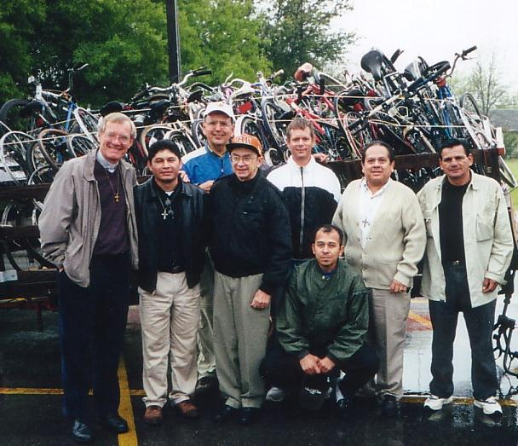
The Group
The bus from Milwaukee was joined by vehicles and trailers from other states. The drivers/riders in the Caravan of Hope gathered in Austin, Texas.

Slide 6
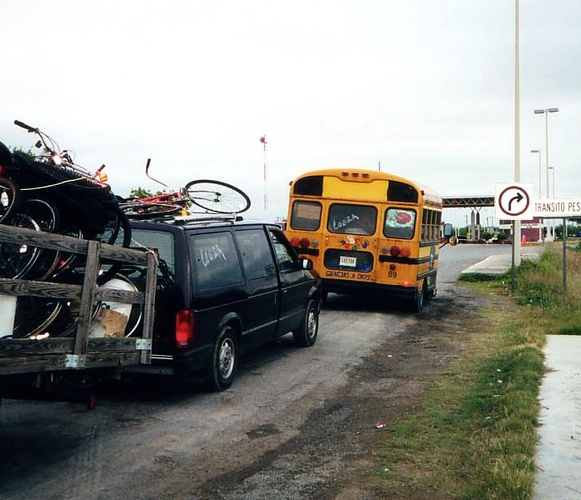
Caravan Crossing
Crossing the border…

Slide 7
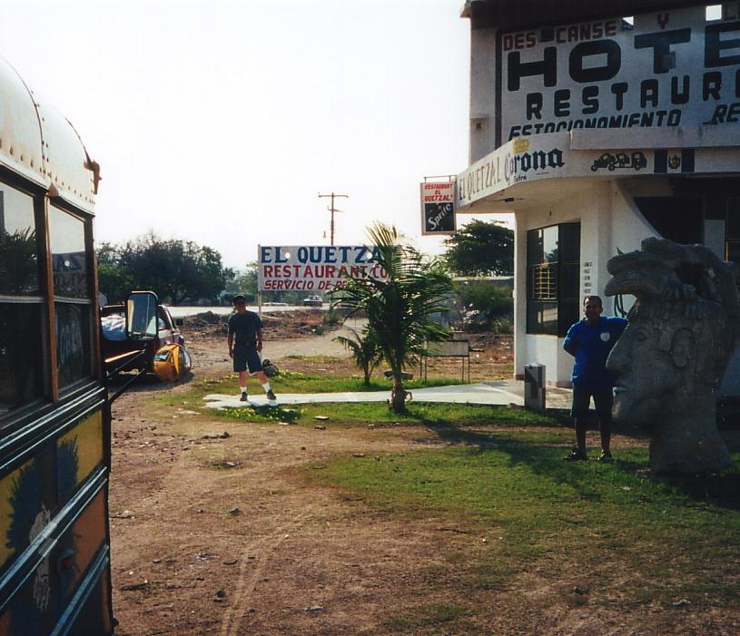
En Route
Breakfast along the way

Slide 8
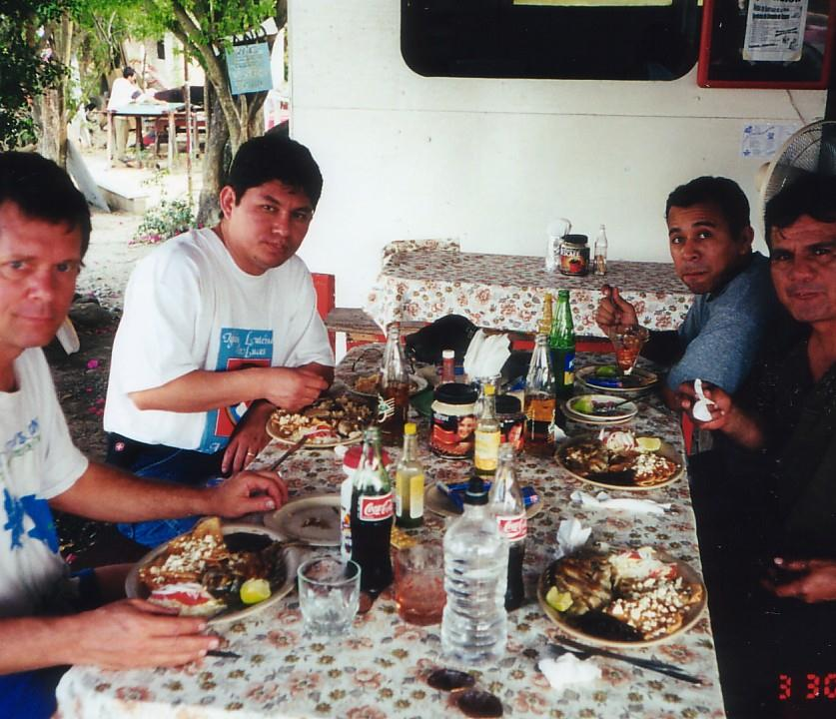
Caravan in Tuxpan
Enjoying a bit of Mexican cuisine

Slide 9
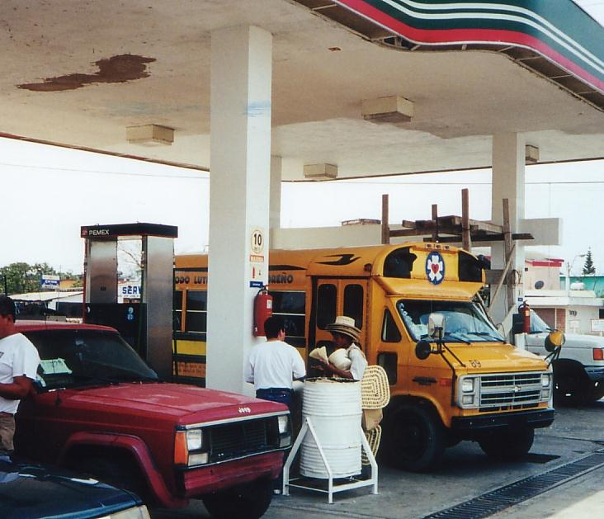
Gassing Up

Slide 10
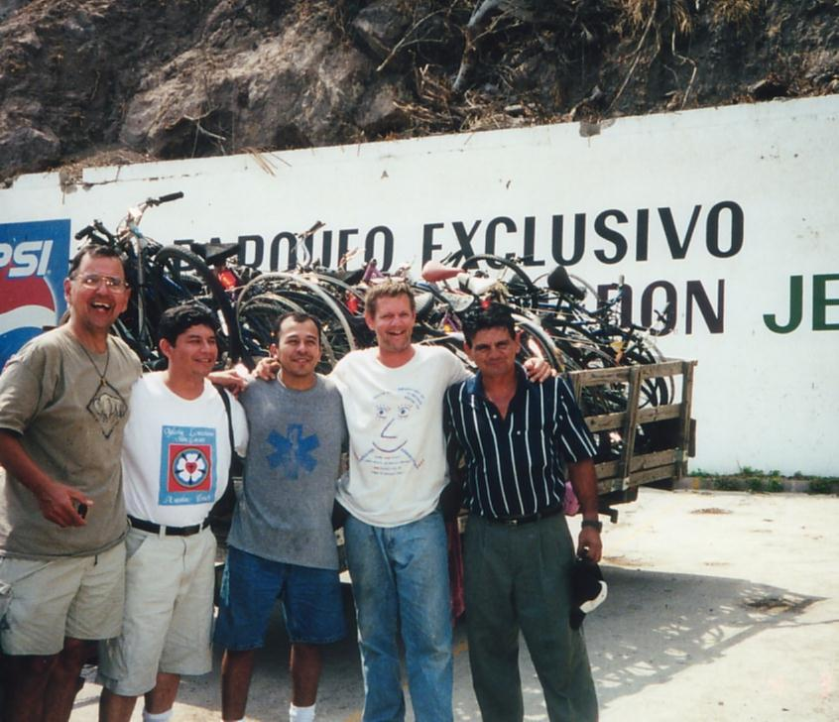
Arrival in El Salvador
Bob (left) and Pastor Walter Baires (2nd from left) are from the Greater Milwaukee Synod

Slide 11
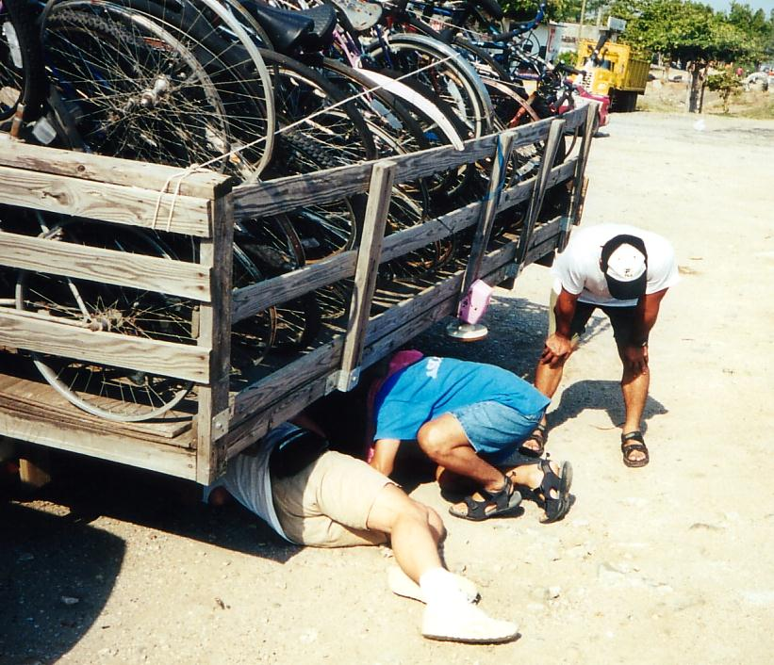
Repairs along the way

Slide 12
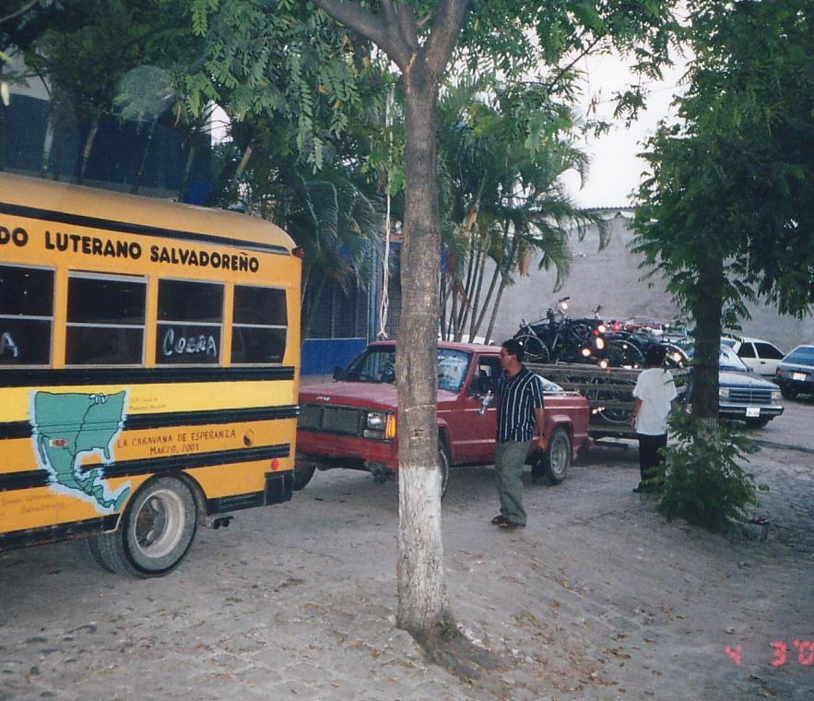
Arrival
The Caravan arrives safely at its destination

Slide 13
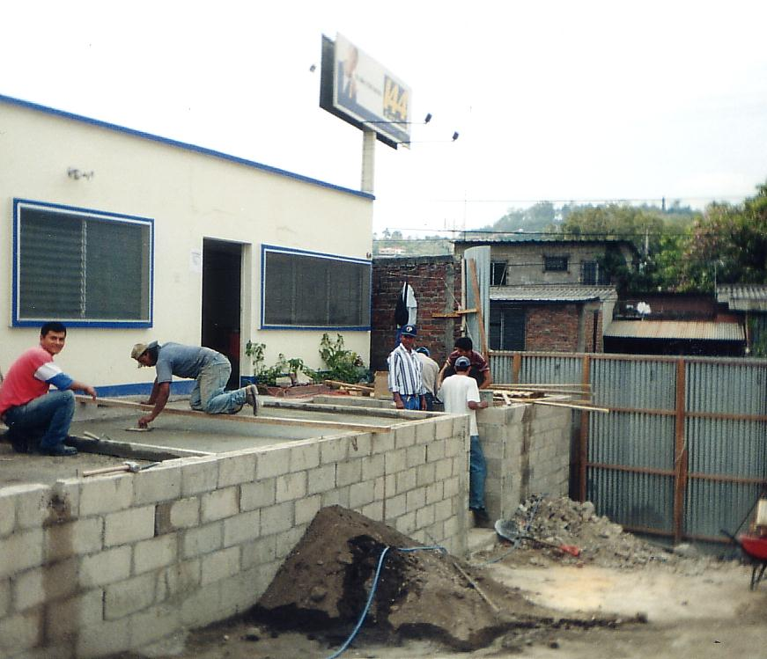
Concordia
The bus arrived at the site of the new Obispado – this building would become “Casa Concordia”

Slide 14
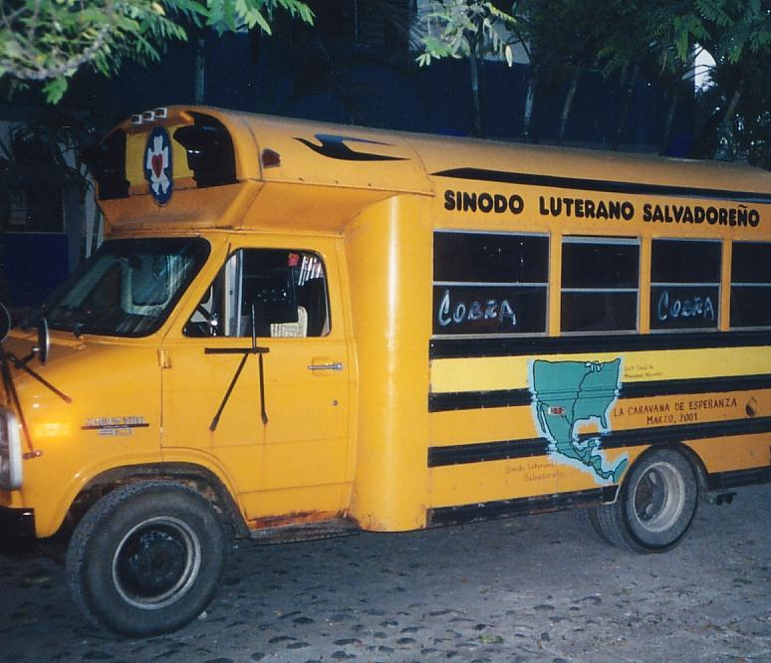
Beto the Bus
The bus became known as Beto, named after “Bob” who wore his “Bob the Tomato” Veggie Tales hat while driving.

